Slide 1
Particle Size Analyzer
Detecting the size distribution of particles in a microscopic image with the help of image processing and deep learning

Slide 2
Problem Statement
We will be given a microscopic image of colloidal particles. Those particles will be in the form of circles in an image. We need to create an application which can detect the circles and also give the size distribution of molecules in the image.
Detecting the sizes of the colloidal particles is important in wide range of scientific and industrial applications, as it can provide valuable information about the properties and behavior of these particles in various systems.

Slide 3
Initial Approach
Initially, we decided to go with raw image processing without the use of any machine learning. We decided to use the HoughCircles Transform from OpenCV which is an algorithm most commonly used to detect circles in an image.

Slide 4
Limitations
It was detecting many false circles.
The parameters of the function needed to be customized for every image to get accurate results.
It was not able detect concentric circles in an image.

Slide 5
Second Approach
Due to so many limitations in our initial approach, we decided to go with the deep learning method in order to get better results.
So, after looking at some object detection algorithms, we decided to go with YOLO V5 (You Only Look Once).
The benefits of this algorithm is that, it is lightweight and has high processing speed and better accuracy than the other algorithms such as R-CNN (Region Based Convolutional Neural Networks), SSD (Single Shot Detector).

Slide 6
Preparation of Dataset
The YOLO algorithm is very easy to use.
Firstly, it needs a good dataset with labelled images to learn from.
The number of images in the dataset should ideally be around 5000 for better results.
As of now, we were able to create a labelled dataset containing 1000 images. Here, labelling means to manually label all the circles from an image so that the algorithm can learn from it.

Slide 7
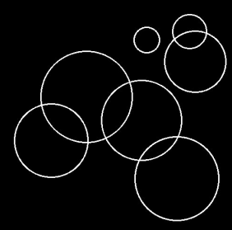
Types of Images Currently Used In The Dataset
Images containing transparent circles:

Slide 8
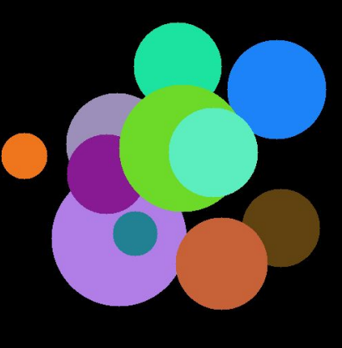
Solid images having different colors (with overlapping):

Slide 9
Results After Training
The model is able to detect almost all the circles with high accuracy. Sometimes, in some pretty complicated images, it misses one or two circles and sometimes detects false circles too.
Following are some examples:

Slide 10
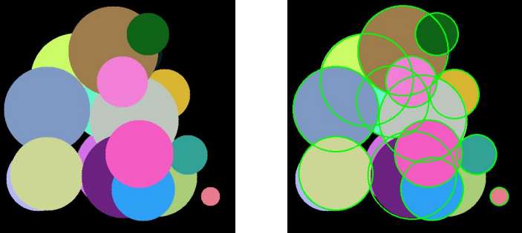
Here, it was able to detect almost all the circles. Only the two circles which are barely visible were not detected. Also, it worked very well on overlapping solid circles.
It did not detect any false circle this time.

Slide 11
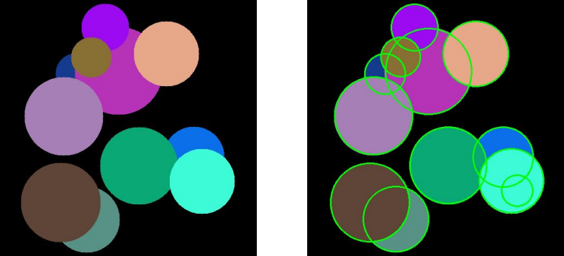
In this example, we can see that the algorithm is able to detect all the circles including overlapping. However, it also detected a false circle inside underneath the cyan
colored circle.

